Slide 1
PROJECT OUTLINE

Slide 2
IINTRODUCTION:
02
“Where do you see yourself in 5 years?”
In a job interview or a performance review, you have likely heard this question at least once. Yet, many applicants and employees continue to provide unsure responses due to their lack of knowledge regarding their career goals.
As an alternative to giving stereotypical answers such as making more money, improving at your current job, or getting an upgrade, why not decide what you want to do next and establish professional goals to help you get there?

Slide 3

You can learn in a right way. Want to be more successful? Actually,
that' s not ambitious enough. Want
03
to be the best?
Our app helps you become more agitated about your career.

Slide 4
Our app' s main goal
04
"Now that everyone's on mobile, it's a matter of time we have an app to facilitate a seamless online learning experience."

Slide 5
OVERVIEW:
05
Our Learning platforms are integrated sets of interactive online tools and resources that provide,
INTERNSHIPS
ACCESS TO OTHER CORPORATE SYSTEMS INDUSTRY & CORPORATE EXPOSURE
WEBINARS/ SEMINARS & WORKSHOPS BY EXPERTS CAREER GUIDANCE
CV BUILDING ASSISTANCE
INTERVIEW PREPARATION ASSISTANCE OFF-CAMPUS PLACEMENT UPDATES JOB ASSISTANCE
JOB OPPORTUNITIES With Us INDUSTRY VISITS ENTREPRENEURSHIP SUPPORT
SOFT/ INTERPERSONAL/ LIFE skills and other educational stakeholders with information, tools, and resources to deliver and manage education.

Slide 6
SOFTWARE REQUIREMENTS:
06
purpose of a mobile splash screen
Splash screens give a basic first experience while your mobile app runs. Image result for splash screen in android They establish the stage for your app while giving the app engine and your app time to load and initialize.
Authentication
After the user submits his credentials at the login page the credentials will be collected and validated against the security repository, which is stored in a database. If the user is found to be matching, the user will be allowed access to the learning portal.

Slide 7
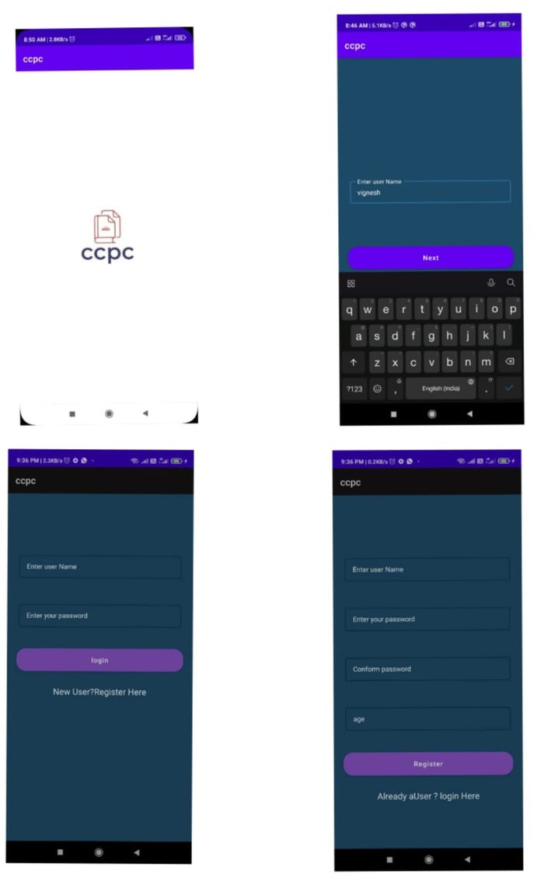

Slide 8
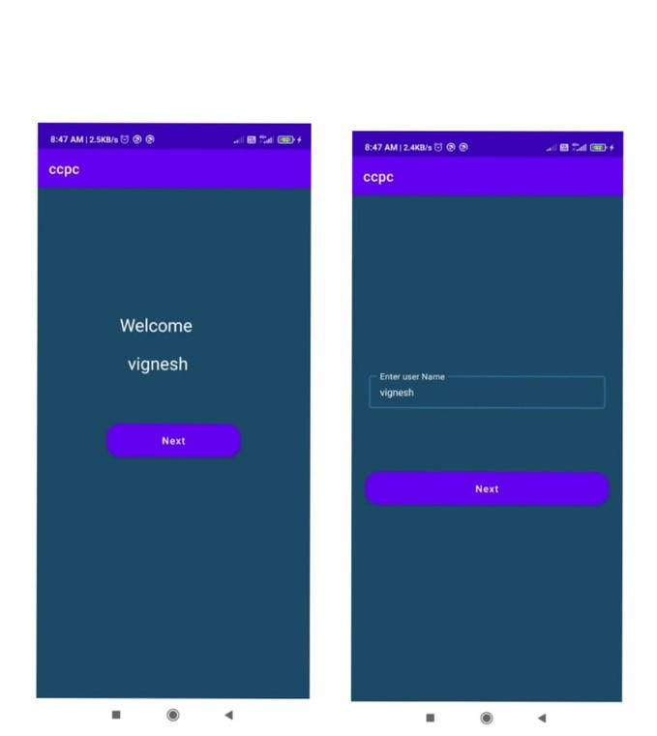
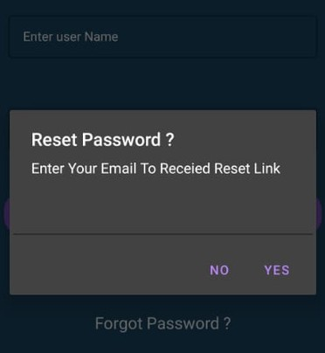
07
welcome page
RESET PASSWORD

Slide 9
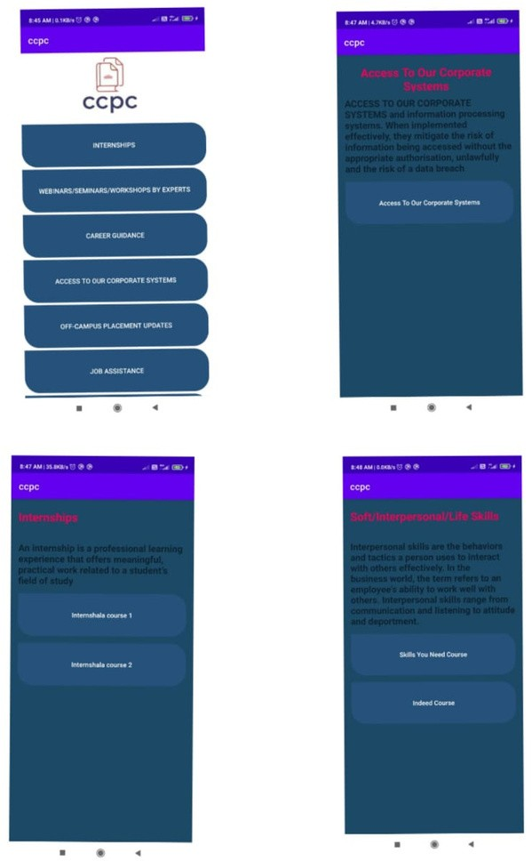
COURSE PAGE

Slide 10
TECHNOLOGY USED
08
ANDROID STUDIO 2021.1.1 (Bumblebee)
Built on JetBrains' IntelliJ IDEA software and developed exclusively for Android development, Android Studio is the official integrated development environment (IDE) for Google's Android operating system. In 2020, it will be offered for download or as a subscription-based service for Windows, macOS, and Linux- based operating systems. It takes the position of the Eclipse Android Development Tools (E-ADT) as the primary IDE for developing native Android apps.

Slide 11
DESIGN AND WORKFLOW
09
We have used a splash screen for our app. When you open an app on your mobile device, you will see a splash screen. It appears while your program is loaded after you've just started it and it is sometimes referred to as a launch screen or startup screen.
First, enter the login details.So that the user can log in and access our app.
if you'r new user then enter the details for registration and login.
after login user can able to view the button that contains each specific course detail's
INTERNSHIPS (including training on industry best practices and technology, real-life projects)
ACCESS TO OUR CORPORATE SYSTEMS
INDUSTRY & CORPORATE EXPOSURE
WEBINARS/ SEMINARS & WORKSHOPS BY EXPERTS CAREER GUIDANCE
CV BUILDING ASSISTANCE
INTERVIEW PREPARATION ASSISTANCE OFF-CAMPUS PLACEMENT UPDATES JOB ASSISTANCE
JOB OPPORTUNITIES With Us INDUSTRY VISITS ENTREPRENEURSHIP SUPPORT SOFT/ INTERPERSONAL/ LIFE SKILLS
On clicking each button, they will redirect the user to the next page that contains the information about the course and rerouting the user to course using hyperlink.

Slide 12
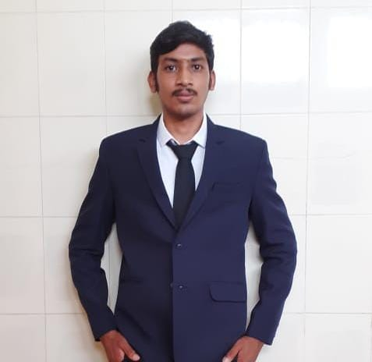


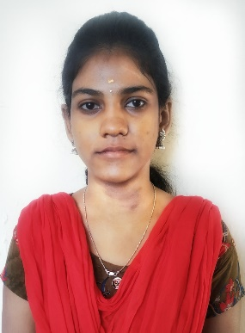

The development team
11
Team Leader
VIGNESH.D
Team Members
ROOBAN.R
RONALDO MATTHEW J R
SIVASHAKTHI KAMATCHI S
SHIVANI.G

Slide 13

10

